Slide 1
Arduino simulation using Proteus
Example 1: Blinking LED 13

Slide 2
Example 2: Traffic light With variable speeds

Slide 3
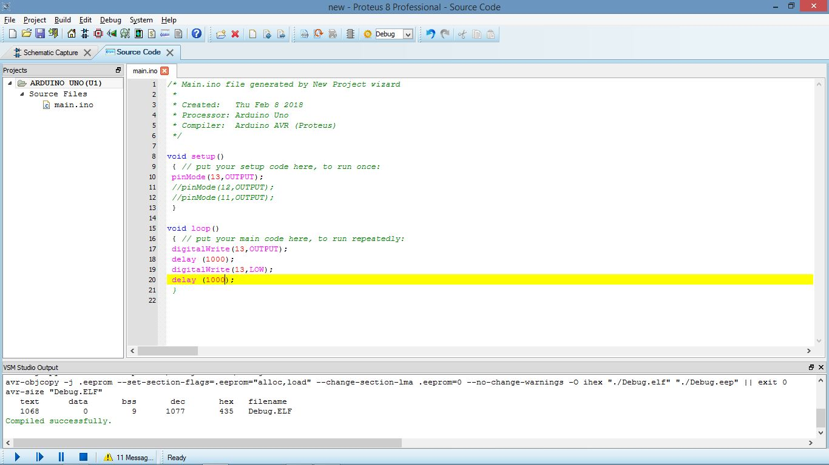
Codes:
Example 1:

Slide 4
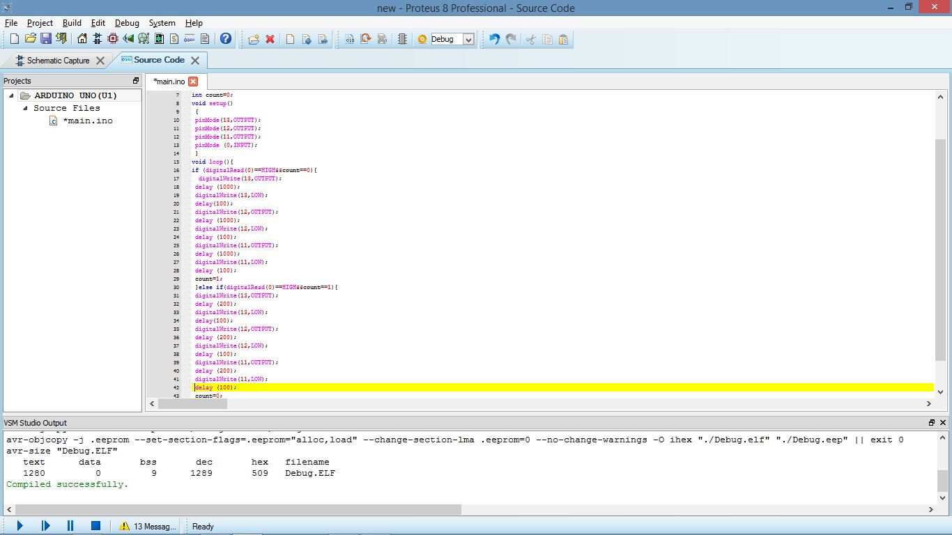
Example 2:

